Slide 1
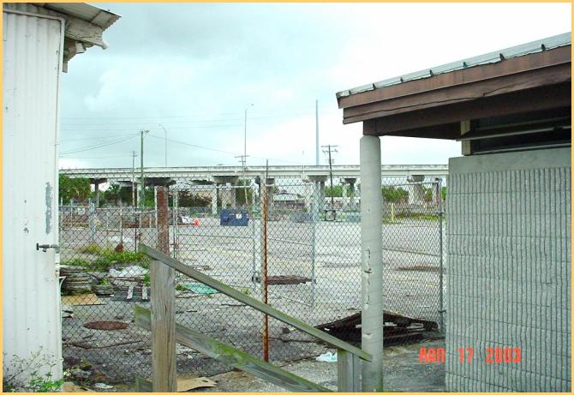

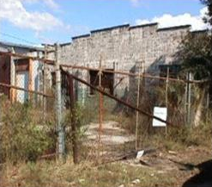

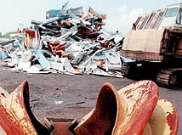




BROWNFIELDS: “Financial and Technical Support for Redevelopment”
HAYWOOD COUNTY, NORTH CAROLINA
BROWNFIELDS COALITION
Presented to:
TOWN OF WAYNESVILLE PLANNING BOARD
November 16, 2015

Slide 2

Presentation Overview
Brownfields Redevelopment Program
  What are Brownfields?
Program Benefits
  Brownfield areas
  Brownfield sites
Brownfield technical and financial tools
Information and Contacts
Notes:
2

Slide 3
What Are Brownfields?

Slide 4
What Are Brownfields?
Brownfield Area - a contiguous area of real properties consisting of one or more brownfields sites (parcels), some of which may not be contaminated with petroleum products or hazardous material. A brownfield site is a single parcel of vacant or improved real property. Brownfield areas or sites may be designated by local government.
Such areas may include all or portions of community redevelopment areas, enterprise zones, empowerment zones, other such designated economically deprive communities and areas, and Environmental Protection Agency-designated brownfield pilot projects. 376.79(4) F.A.C.
Notes:
4

Slide 6
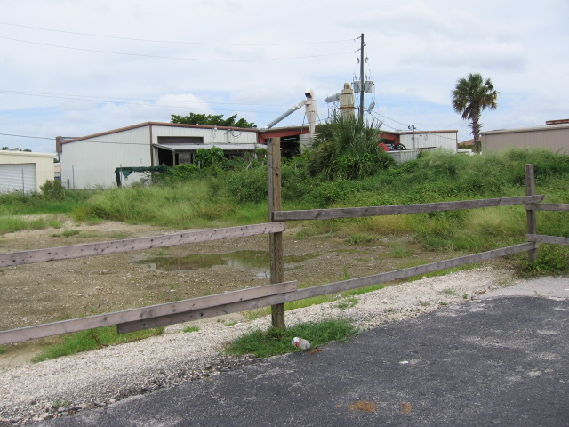

Slide 7
Common Brownfield Myths And Facts
MYTHS
Superfund sites are brownfields, or brownfields are
Superfund sites.
FACT: Under the statutory definition, brownfields do not include Superfund sites on the National Priorities List (NPL). A small number of Superfund sites, approximately 1,200, have been designated NPL sites and are managed under a more elaborate process than most brownfield sites.
Brownfields are only an urban problem.
FACT: Contaminated properties affect nearly every town, large and small. Small and rural communities are impacted not only by former industrial sites, but by closed gas stations, dry cleaners, old dumps, contaminated rail yards, mine-scarred lands, agricultural wastes such as pesticides, and many other challenges. Many
EPA brownfield grants have been awarded to communities with
less than 25,000 people.
Notes:
7

Slide 8
Common Brownfield Myths And Facts
MYTHS
Brownfields are all large, former industrial or manufacturing sites.
FACT: While some brownfields are large former industrial sites, the majority of the estimated 500,000 to 1 million brownfields in the United States are small properties like dry cleaners, vacant lots, or gas stations.
A site must actually be contaminated to be considered a brownfield.
FACT : The perception that a property may be contaminated can be just as great a barrier to redevelopment as actual contamination. Therefore, sites where contamination is merely perceived, and site conditions are unknown, are still considered brownfields. One third of the brownfield sites that have been assessed with EPA brownfields funding have turned out to be free from significant contamination.

Slide 9
Common Brownfield Myths And Facts
MYTHS
Superfund sites are brownfields, or brownfields are Superfund sites.
FACT: Under the statutory definition, brownfields do not include Superfund sites on the National Priorities List (NPL). A small number of Superfund sites, approximately 1,200, have been designated NPL sites and are managed under a more elaborate process than most brownfield sites.
Brownfields are only an urban problem.
FACT: Contaminated properties affect nearly every town, large and small. Small and rural communities are impacted not only by former industrial sites, but by closed gas stations, dry cleaners, old dumps, contaminated rail yards, mine-scarred lands, agricultural wastes such as pesticides, and many other challenges. Many EPA brownfield grants have been awarded to communities with less than 25,000 people.

Slide 10
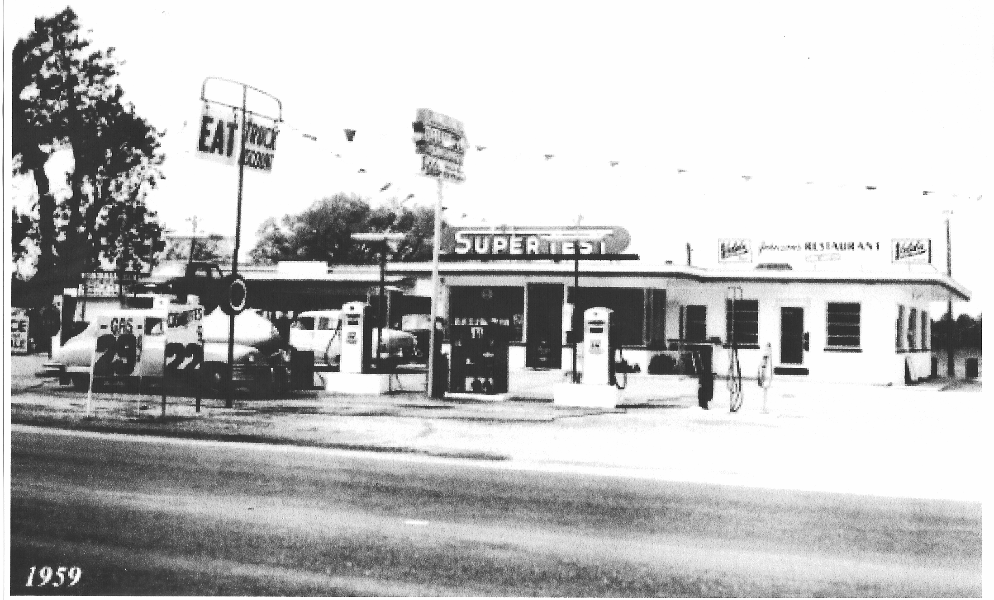
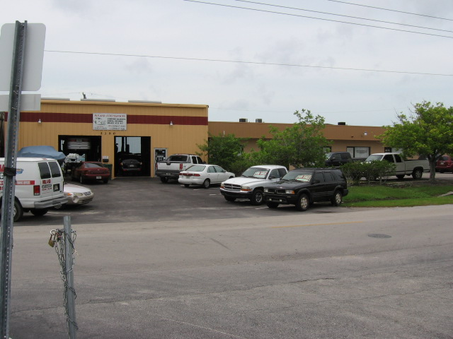
Car Repair Shop

Slide 11
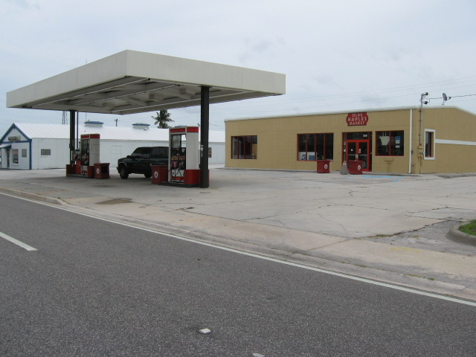
Gas Station

Slide 12

WHAT ARE BROWNFIELDS?
PROPERTY WHERE THERE IS REAL OR PERCEIVED EXISTENCE OF ENVIRONMENTAL IMPACTS

Slide 13
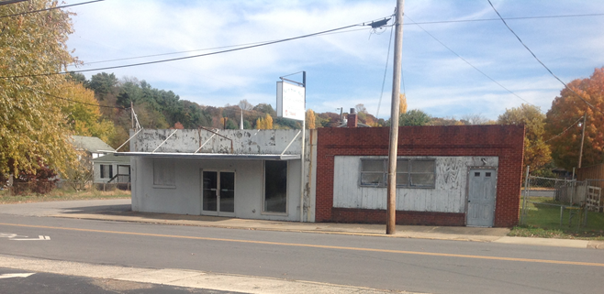

Slide 14
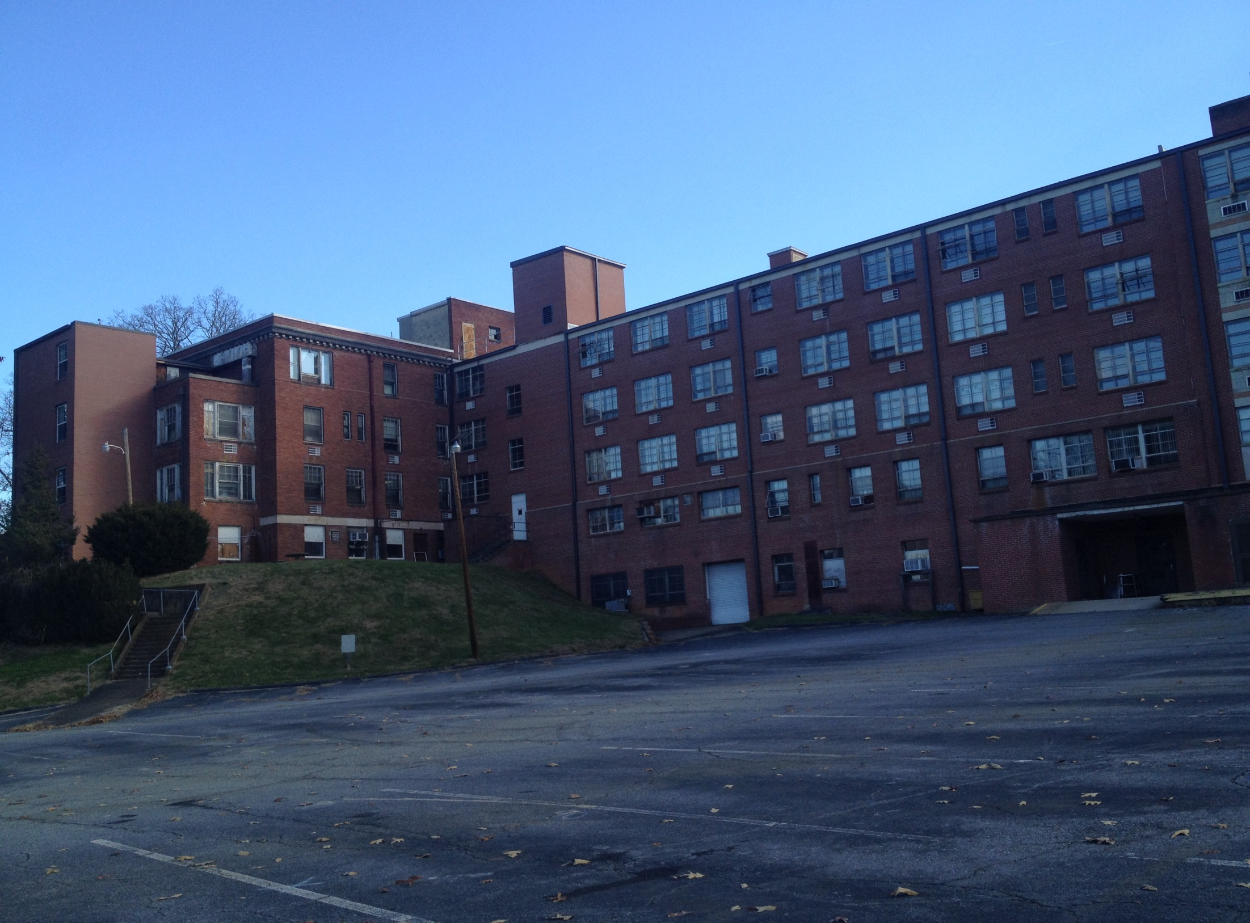

Slide 15
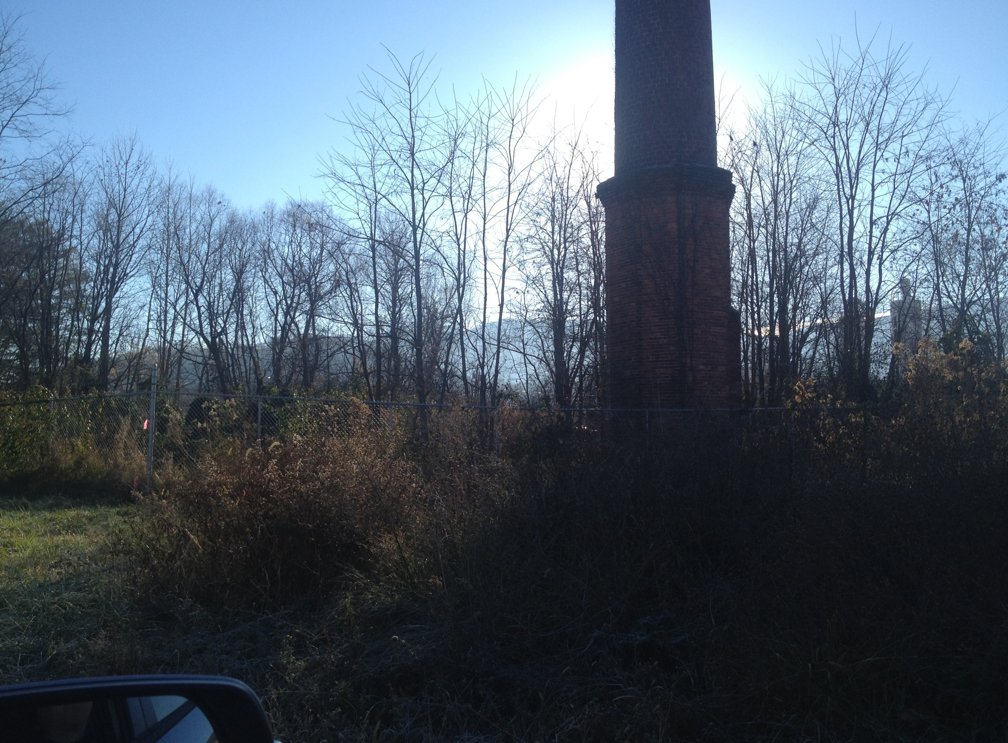

Slide 16
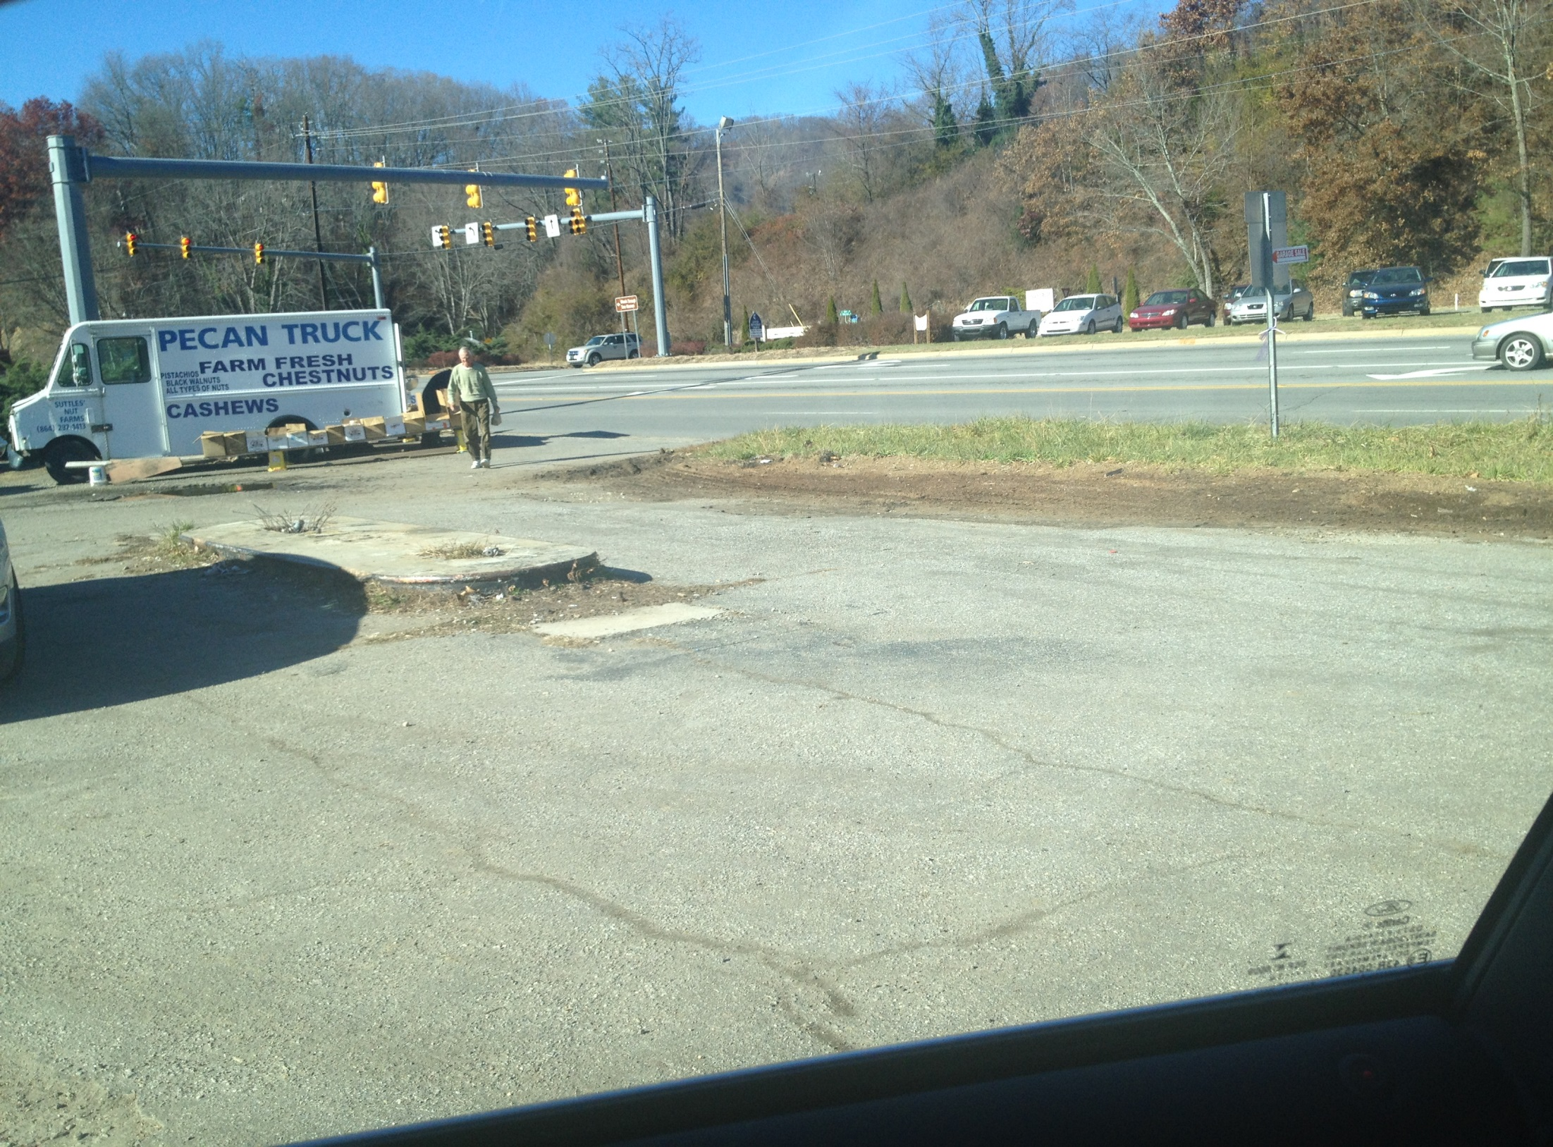

Slide 17
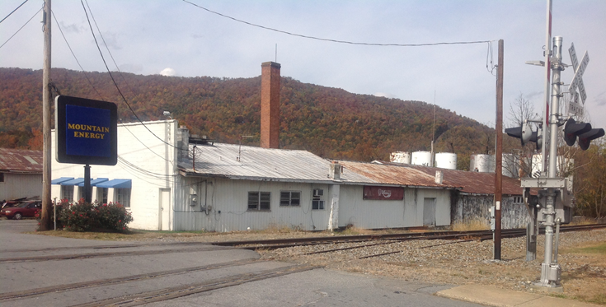
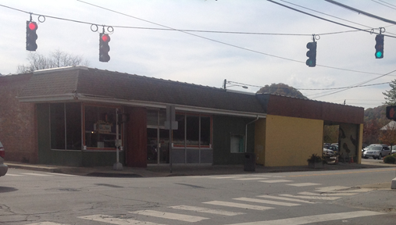
EPA Brownfields Program
A Redevelopment tool that
can facilitate:
  Historic Preservation
  Economic development
  Community development
  Residential projects, and
  Open-Space/ Green-Space projects
  and
  Reduction of public health and environmental hazards
  Removal of stigma
  Promoting effective use of community resources
)

Slide 18
US ENVIRONMENTAL PROTECTION AGENCY BROWNFIELDS GRANTS
EPA’s Brownfields Program provides funds to empower states, communities, tribes and nonprofits to prevent, inventory, assess and clean up brownfield properties.
EPA provides brownfields funding for three types of grants:
Brownfields Assessment Grants – provide funds to inventory, characterize, assess, and conduct planning (including cleanup planning) and community involvement related to brownfield sites.
Brownfields Cleanup Grants – provides funds to carry out cleanup activities at a specific brownfield site owned by the applicant.
Brownfields Revolving Loan Fund (RLF) – provides funds for a grant recipient to capitalize a revolving fund and to
make loans and provide sub-grants to carry out
cleanup activities at brownfield sites.

Slide 19
ASSESSMENT GRANT OPTION SUMMARY
Community-Wide Grants
Up to $200,000 for hazardous substances and $200,000 for petroleum
No waiver of funding limit
Maximum combined amount $400,000
May also apply for a site-specific grant; may not apply as a member of a coalition
Site-Specific
Up to $200,000 for petroleum or hazardous substances
May request a waiver for up to $350,000
Maximum amount $350,000
May also apply for a community-wide grant; may not apply as a member of a coalition
Coalition
Up to $1,000,000 for petroleum and/or hazardous substances
No waiver of funding limit
Maximum amount $600,000
May not apply for an individual community-wide or
site-specific grant or as part of another coalition

Slide 20
BROWNFIELDS GRANTS
US ENVIRONMENTAL PROTECTION AGENCY
The Brownfields Law expands eligibility for brownfields funding by broadening the entities eligible for funding by permitting the award for cleanup grants to include nonprofit organizations that own the property.
Cleanup Grants. Grants may be awarded up to $200,000 per site for cleanup, with a maximum
of 3 sites per entity.

Slide 21



PPM CONSULTANTS, INC.
PRESERVING THE ENVIRONMENT AND HISTORIC RESOURCES THROUGH BROWNFIELDS REDEVELOPMENT
PPM Consultant, Inc.
407-443-8892
www.ppmco.com

