Slide 1

Haywood County Schools
COUNTY COMMISSIONERS’
Work Session
April 14, 2016

Slide 2

Demographic Information
15 public schools serving 7,188 students
8 – Elementary Schools
3 – Middle Schools
4 – High Schools (2 traditional, 1 alternative , and 1 early college high school)
1 – Dropout recovery program (Haywood Community Learning Center)
6 – Pre-K Programs
The Free/Reduced meal rate is 54.45%.

Slide 3

Haywood County Schools
10-Year Enrollment History
10 Day ADM
2015-2016 | 7188
2014-2015 | 7400
2013-2014 | 7584
2012-2013 | 7567
2011-2012 | 7677
2010-2011 | 7694
2009-2010 | 7742
2008-2009 | 7892
2007-2008 | 8013
2006-2007 | 7933
-745 students from 2006-07 ------- 2015-16
Board of Education
Charles H. Francis, Chairman; Lynn Milner, Vice-Chair;
Jim Harley Francis, Larry Henson, Steven Kirkpatrick,
Walt Leatherwood, Bobby Rogers, Jimmy Rogers, Rhonda Schandevel
Board of Education
Charles H. Francis, Chairman; Lynn Milner, Vice-Chair;
Jim Harley Francis, Larry Henson, Steven Kirkpatrick,
Walt Leatherwood, Bobby Rogers, Jimmy Rogers, Rhonda Schandevel

Slide 4
Board of Education voted February 16, 2016 to close Central Elementary School and to decrease the 2016-17 budget by 2.4 million dollars.
The consideration to close the school was not based upon Central Elementary School’s capacity. It was based upon the overall decrease in enrollment in the school and district, the need to reduce the local budget by 2.4 million dollars, and the proximity of neighboring schools that could accommodate the students and staff.

Slide 5
2.4 Million Cut – Board voted 02-16-16

Slide 6
Personnel

Slide 7

Performance
Ten years ago we ranked 40th among 117 district in academic performance.
In 2012-13, HCS outperformed (composite) 85% of the other school districts in the state. The district was ranked 17th of 115 school districts.
In 2013-14 and 2014-15, HCS outperformed (composite) 87% of the other school districts in the state. The district was ranked 15th of 115 school districts.

Slide 8
Performance Letter Grades
The NC General Assembly passed legislation requiring a letter grade for individual schools.
2013-14
2014-15
While the grades across the state correlated closely with poverty rates, there are “outliers” in the data. Some wealthy schools performed pretty low and some high poverty schools perform well. This was true for regular and charter schools. We are an academic outlier … high poverty and high performance.
Letter Grade | All NC Schools | Charter Schools | Haywood County Schools
A | 5.4% | 11.1% | 12.5%
B | 24.0% | 29.4% | 31.25%
C | 41.4% | 27.8% | 50%
D | 23.1% | 17.5% | 0%
F | 6.0% | 13.5% | 0%
Letter Grade | All NC Schools | Charter Schools | Haywood County Schools
A or A+ | 2.1% | 7.5% | 13.3%
B | 19.1% | 44.8% | 53.3%
C | 43.3% | 21.6% | 33.3%
D | 29.4% | 18.7% | 0%
F | 6.1% | 7.5% | 0%

Slide 9
FUND BALANCE
FY 2012-13 | $ 5,019,203.00
 |  | FUND BALANCE USED
FY 2013-14 | $ 4,623,674.00 | $ 395,529.00
FY 2014-15 | $ 3,515,292.00 | $ 1,108,382.00
FY 2015-16 | $ 1,933,961.00 | Fund Balance Appropriated
 | $ 1,316,446.00 | Unassigned

Slide 10
2016-17 FISCAL YEAR BUDGET
Budget Assumptions:
Expenses:
3% salary increase – all employee categories
15.65% matching retirement – a .33% increase
$5,571.00 matching hospitalization – a $100.00 annual increase
Revenues:
County Appropriation – $15,052,884.60
FY 2015-16 10-day ADM of 7444 @ $2,022.15 PPA
The anticipated budget needs for 2016-17 are $15,445,168.53.

Slide 13
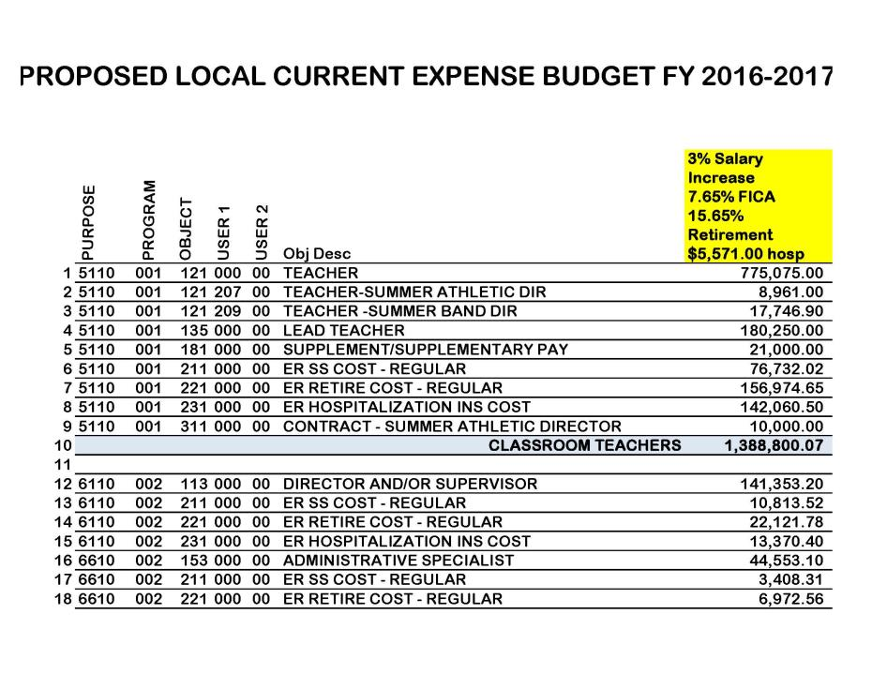

Slide 14
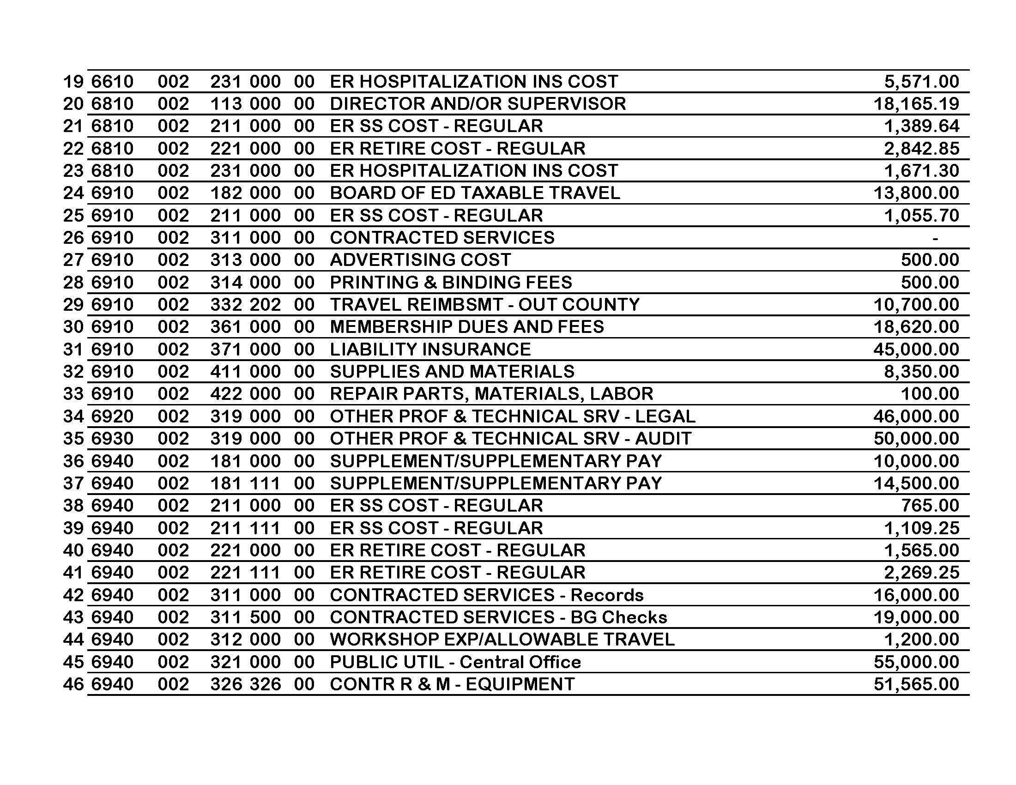

Slide 15
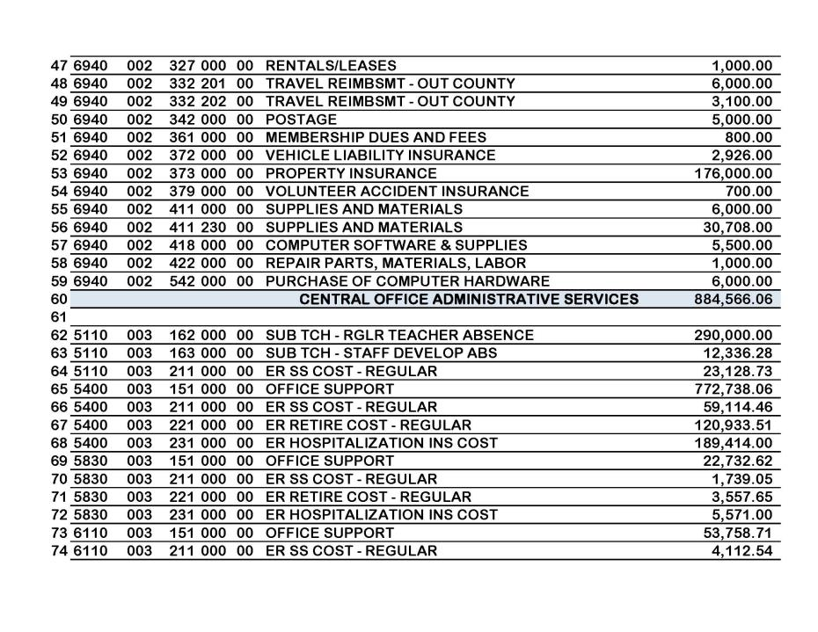

Slide 16
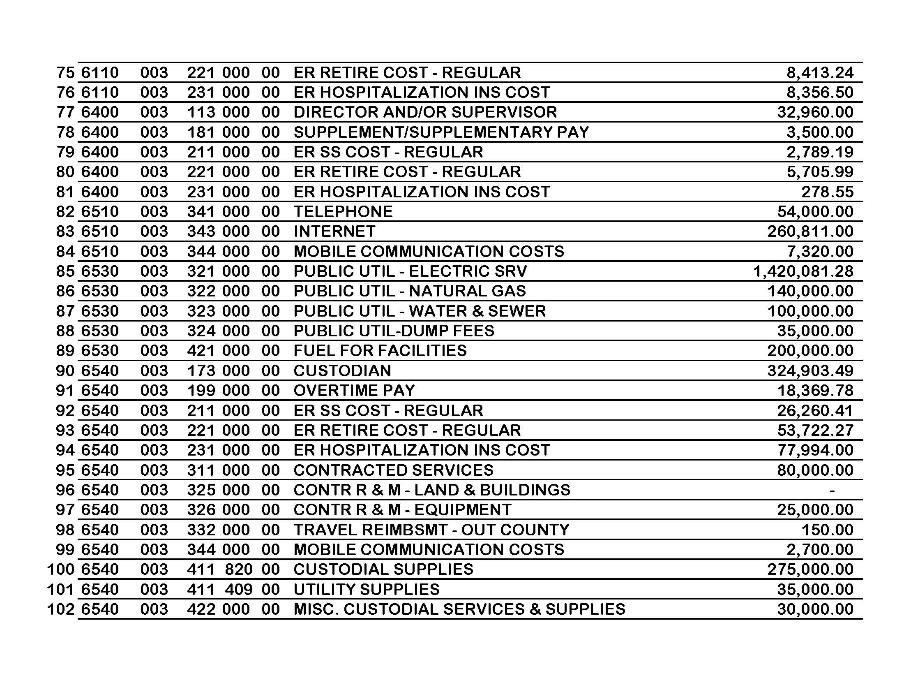

Slide 17
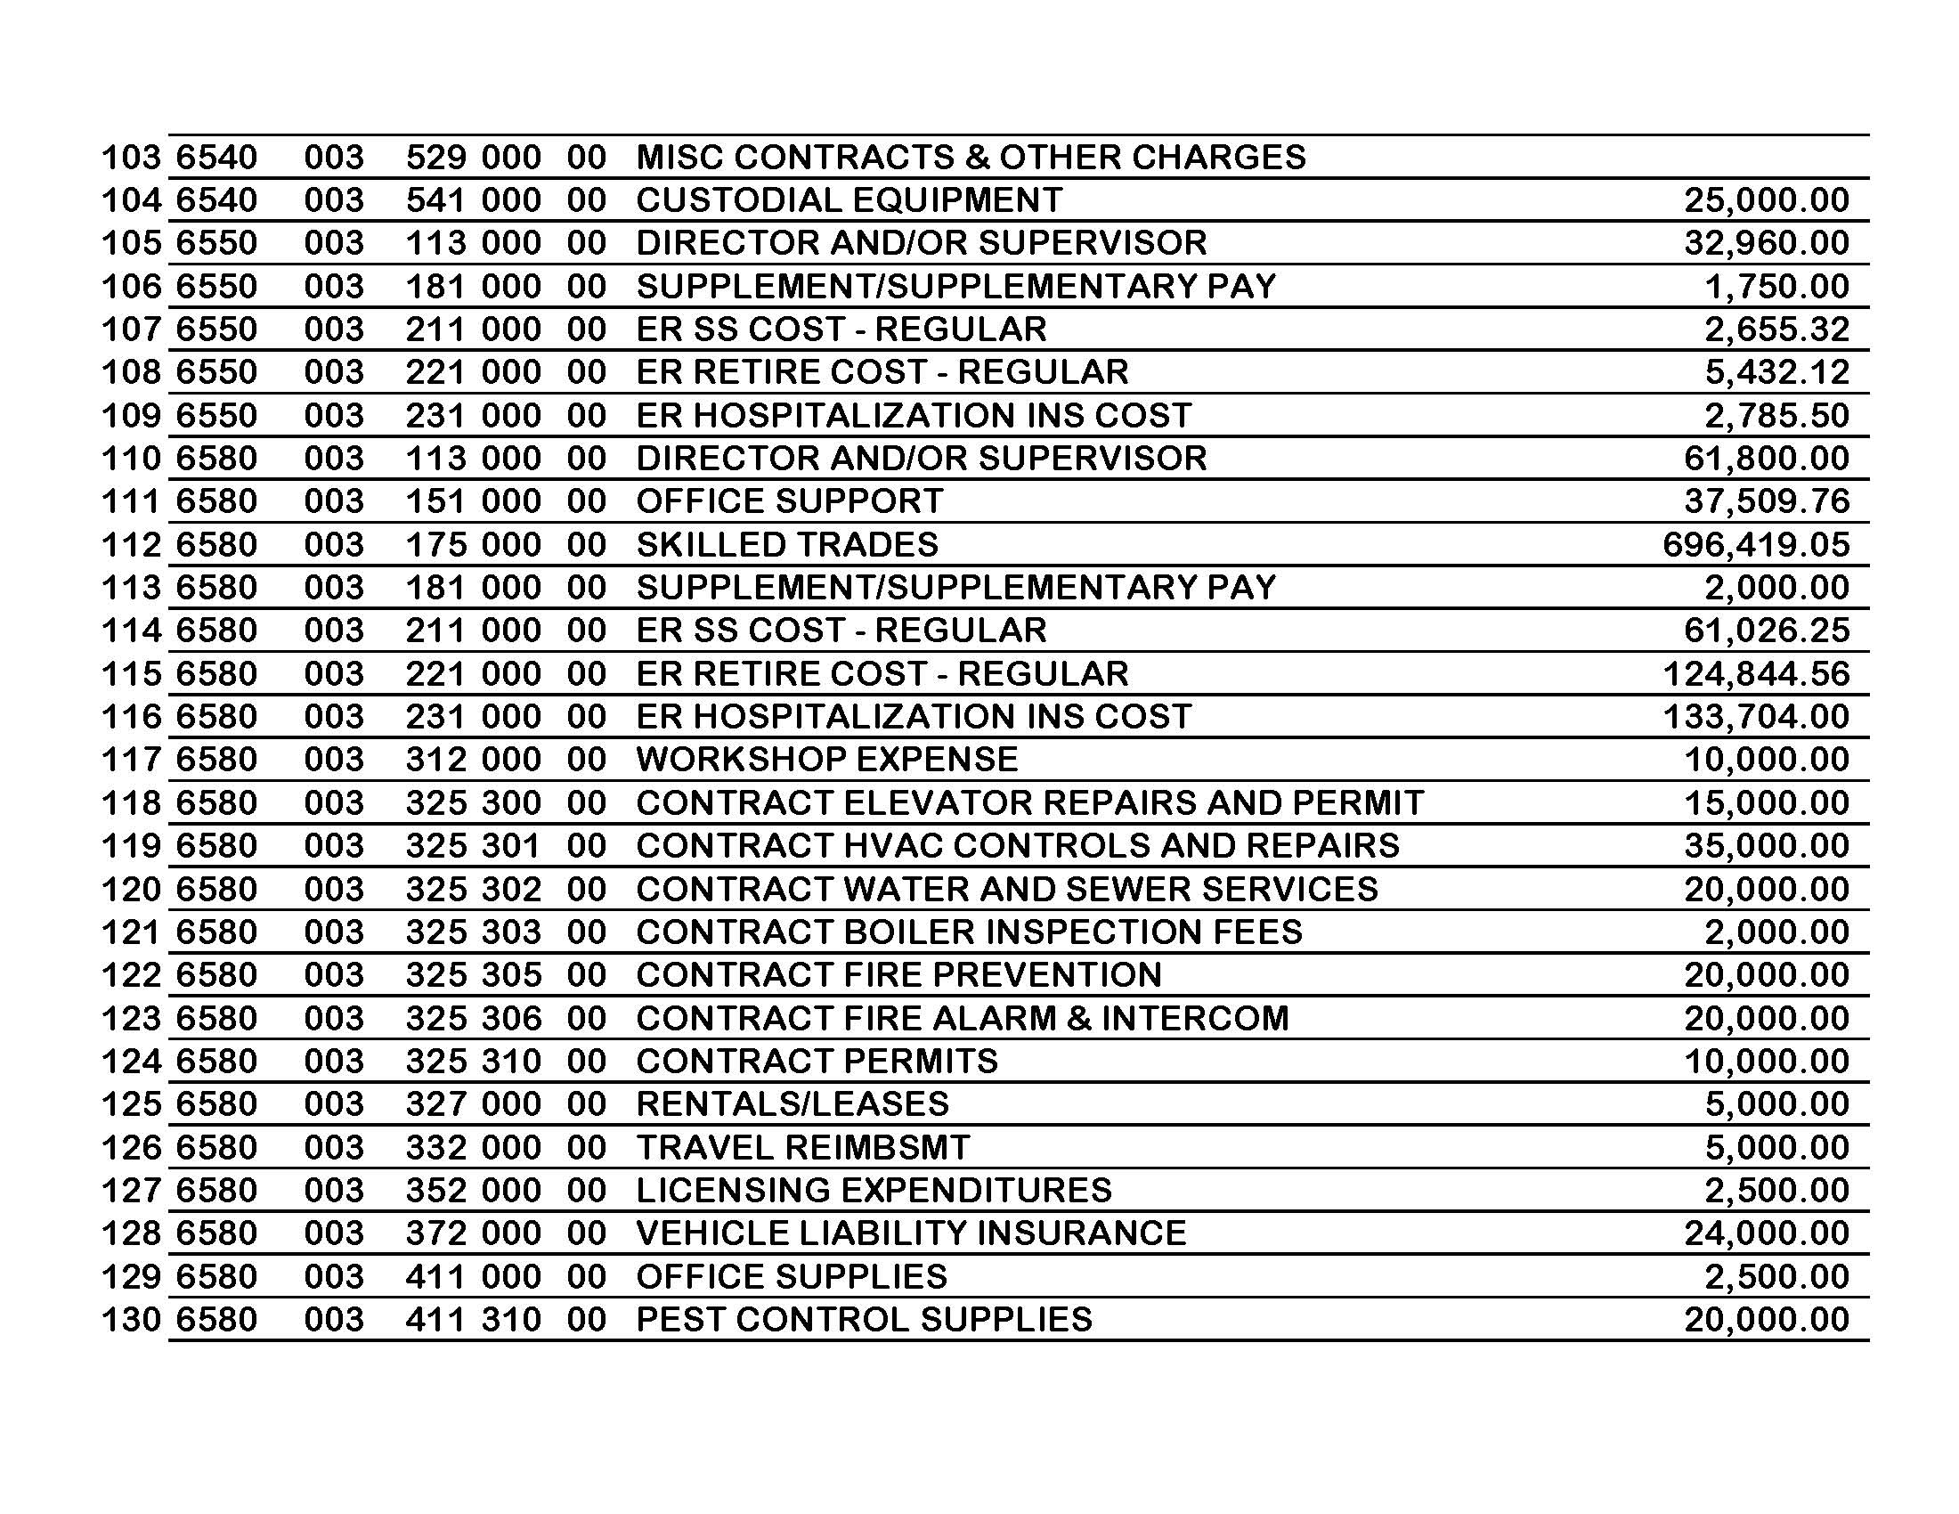

Slide 18
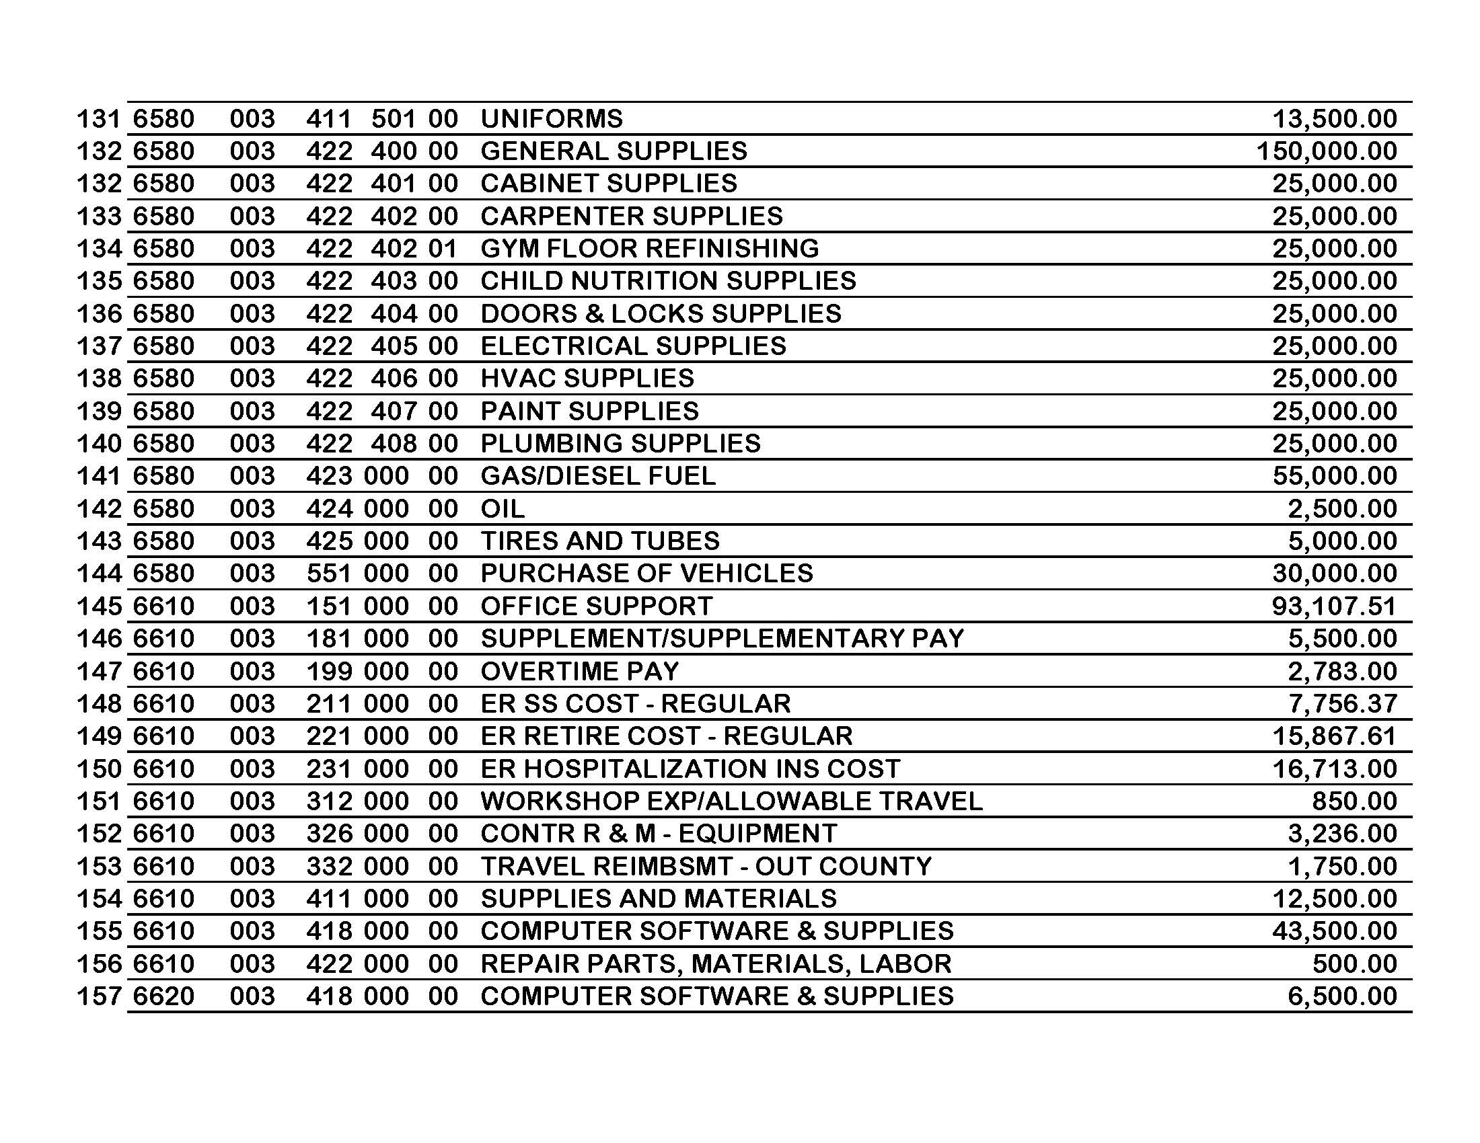

Slide 19
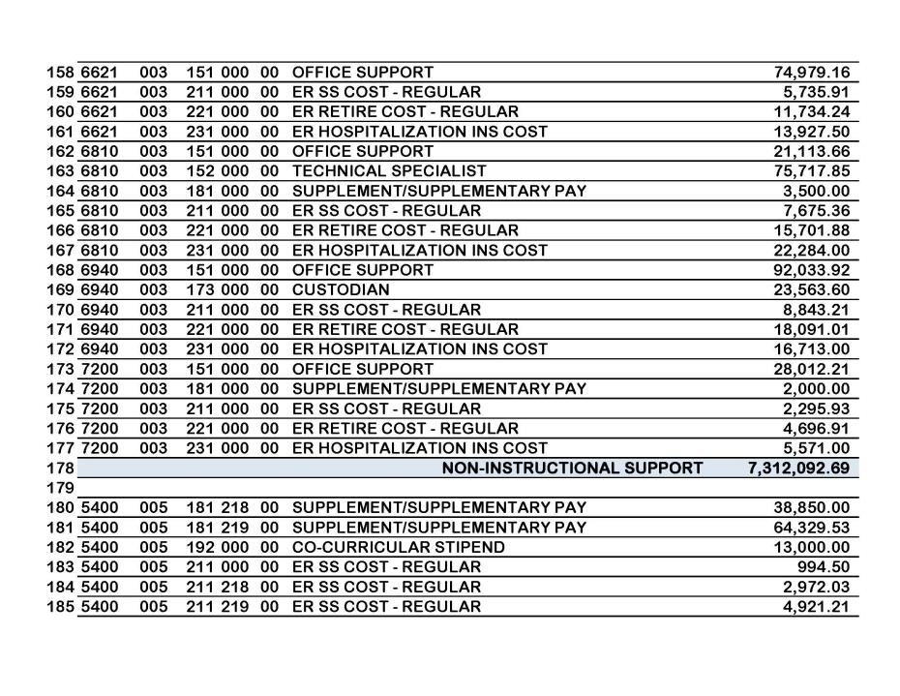

Slide 20
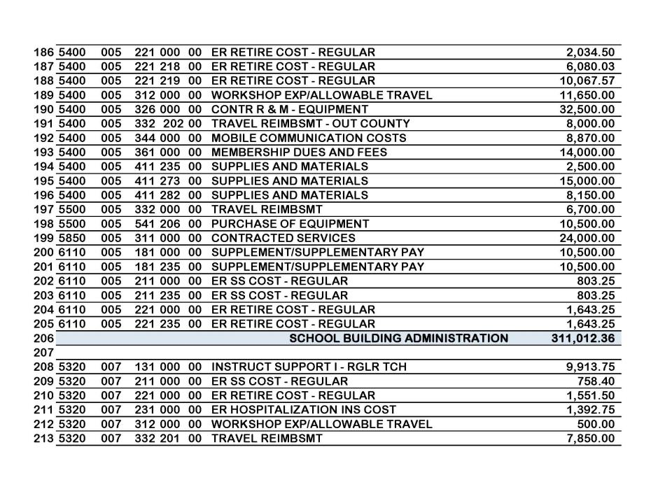

Slide 21
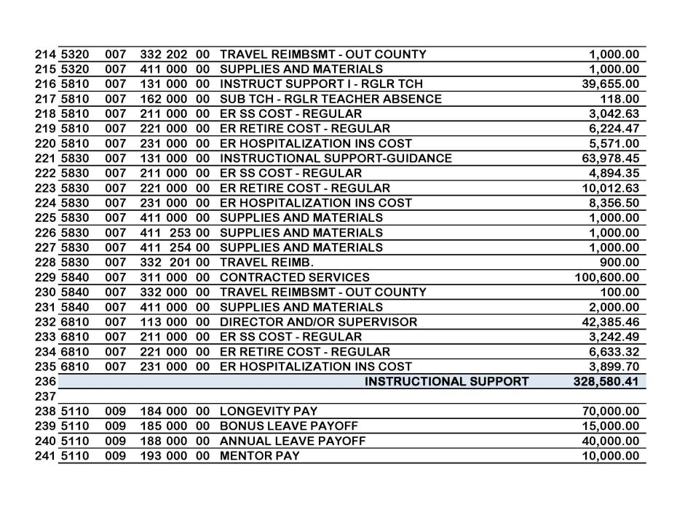

Slide 22
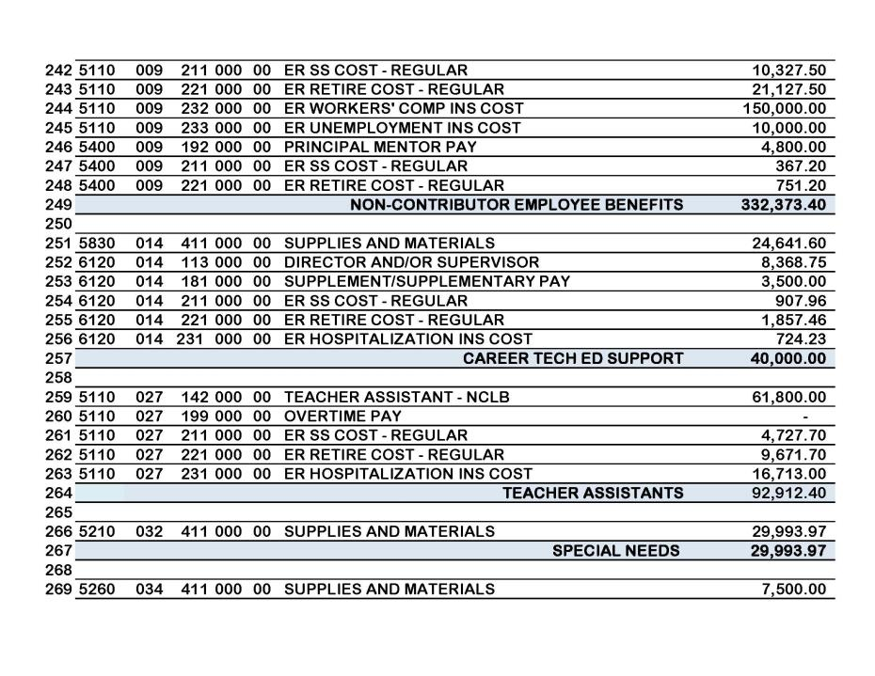

Slide 23
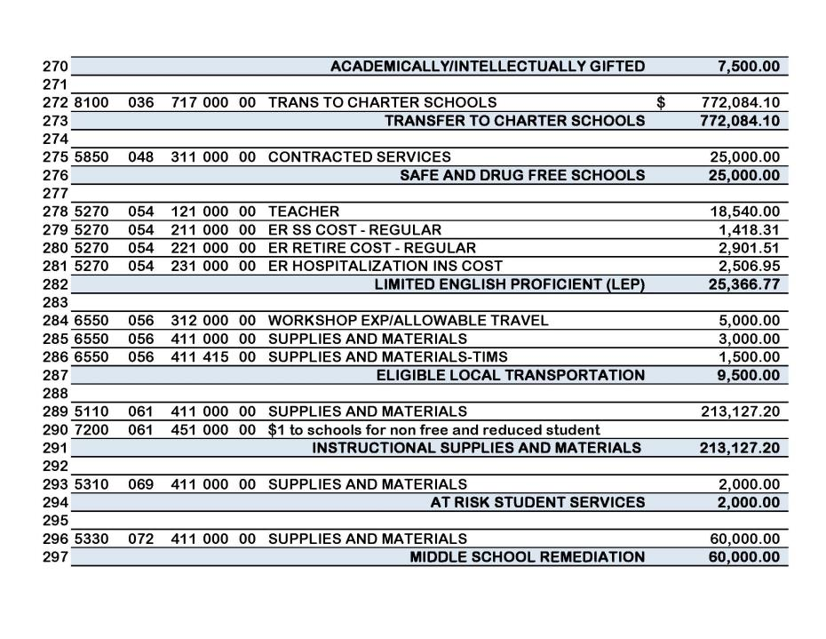

Slide 24
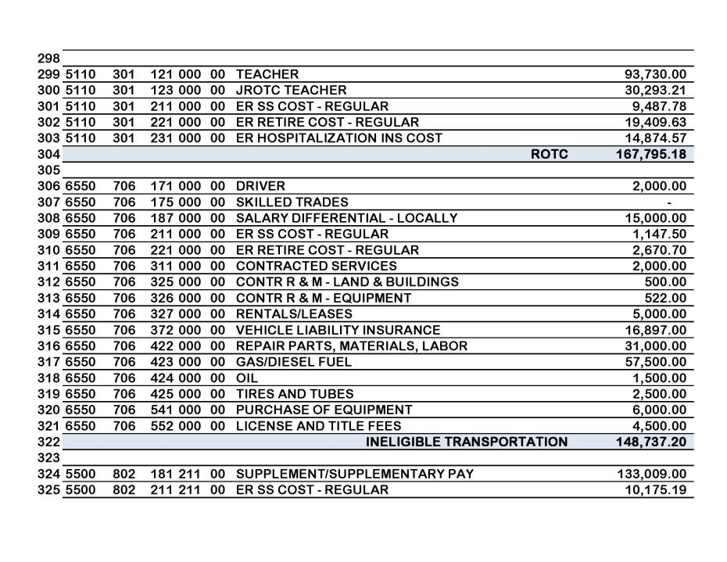

Slide 25
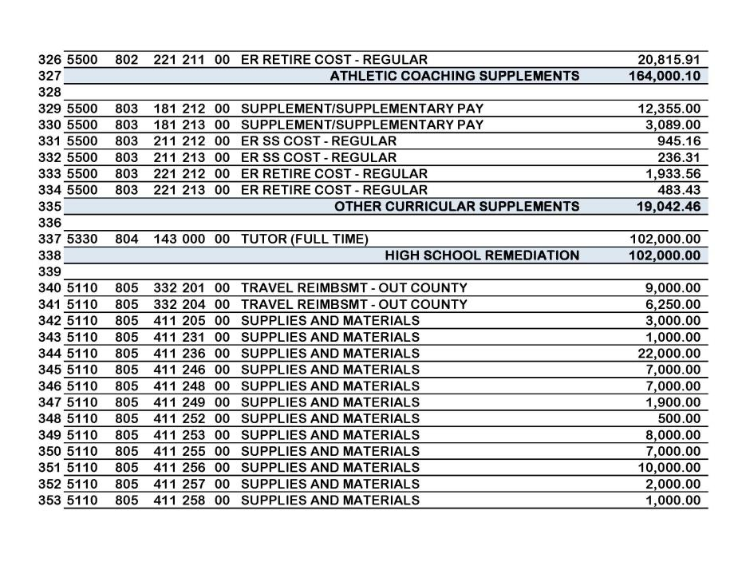

Slide 26
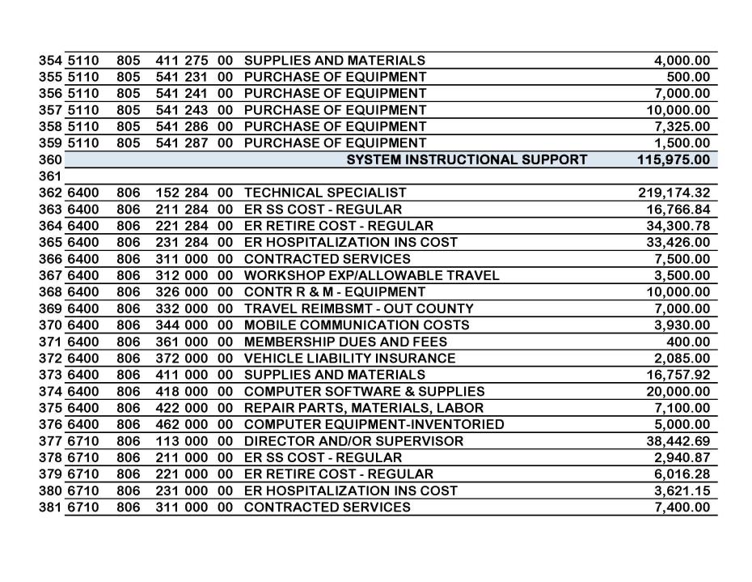

Slide 27
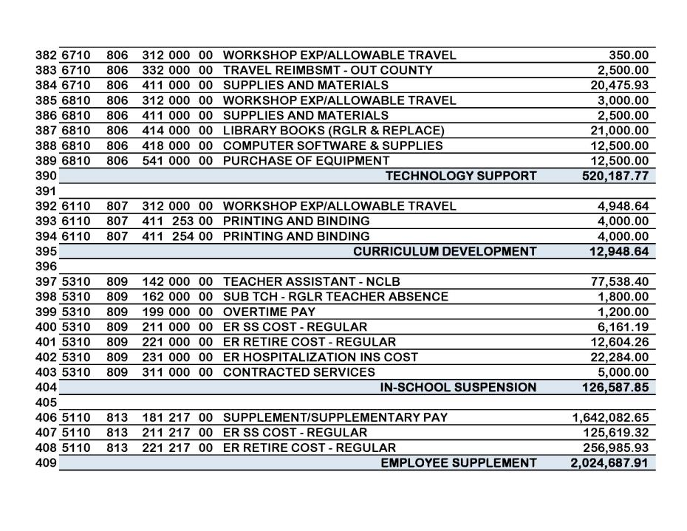

Slide 28
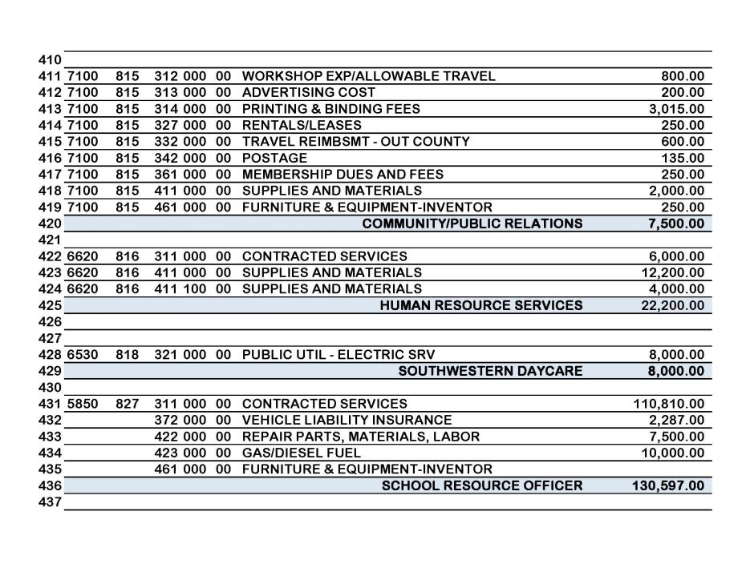

Slide 29
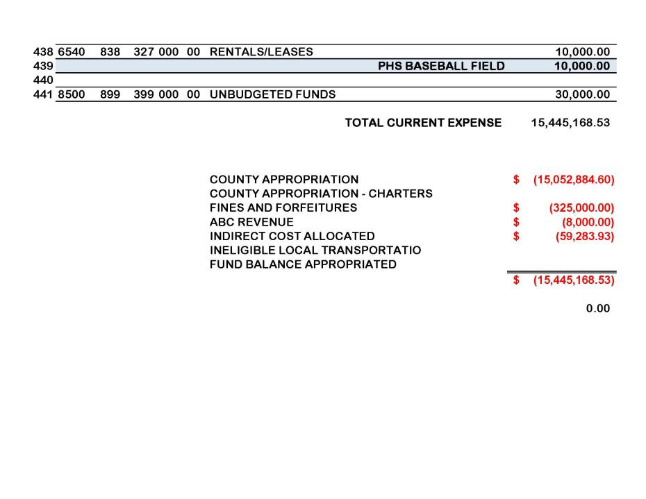

Slide 30
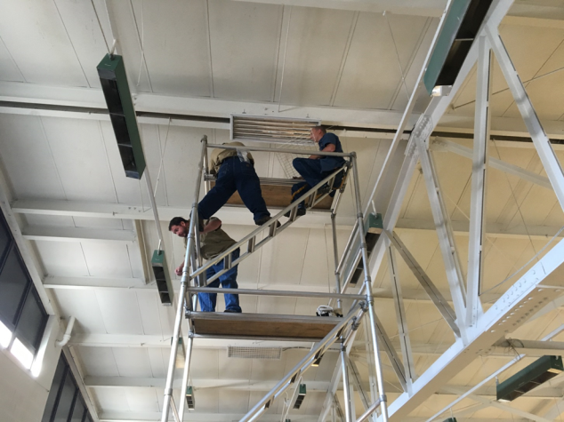
Gym Light Replacement
Notes:
Grant thru WNC Communities totaling $27,253.47 Haywood County Schools Match is estimated at $28,500 for labor and misc. material
Allowed the replacement of over 100 Lights. At Multiple locations Tuscola Gym, Pisgah Gym, Conference Center gym, lay in lights, Parking lot lights at Junaluska
The cost to operate these lights is over
$70.00 per day $352.58 Week $16,923.65 Year
With an estimated energy savings of over
$20.00 per day $100.00 per week $5354.50 per Year

Slide 31
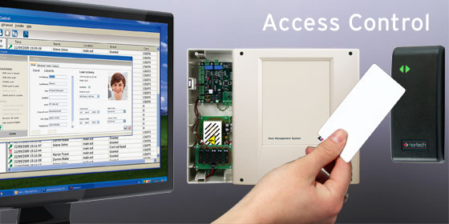
Access Control
Notes:
North Canton will be a pilot school for our access control With a total of 15 exterior doors
4 sites with 40 doors Tuscola Testing, Maintenance Shop,
With the use of ADM Funds totaling $55,131.07 we will implement this program
Ability to restrict access for facility use to organizations for only the time frame allotted
Time stamp activity at each campus to track usage

Slide 32
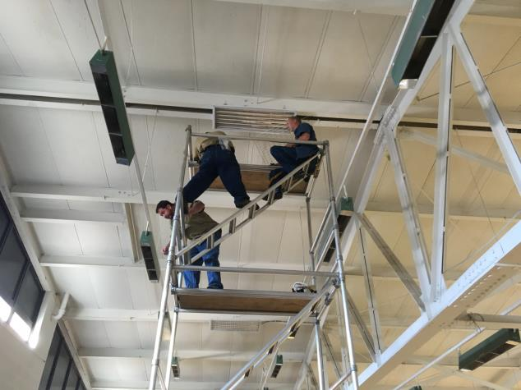
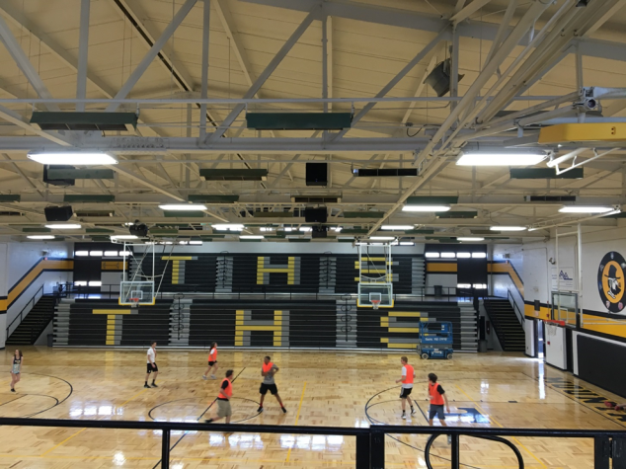
Heating and Air Conditioning
Notes:
Old radiant heaters fill our gymnasiums. Many heaters are in need of repair or replacement and the age restricts the ability to locate parts
With the aging heaters and higher cost of electricity, we would be able to offset the energy expense with the addition of heat pumps and duct socks.
The cost to heat would decrease and the ability to maintain humidity levels in our gyms would increase prolonging the life of our facilities.
An Estimated cost of construction would total $100,000 per gym

Slide 33
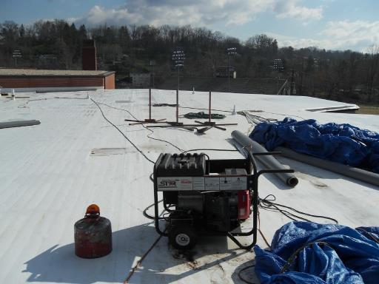
Roof Replacement
Notes:
Roof Replacement at Canton Middle School
With this replacement, tapered insulation was added to allow slope along with increase the efficiency of the building.
Typical flat roofs hold water which increase the likelihood of leaky roofs.
Waynesville Middle School Cafeteria Roof is next on our list of roofs to replace.

Slide 34
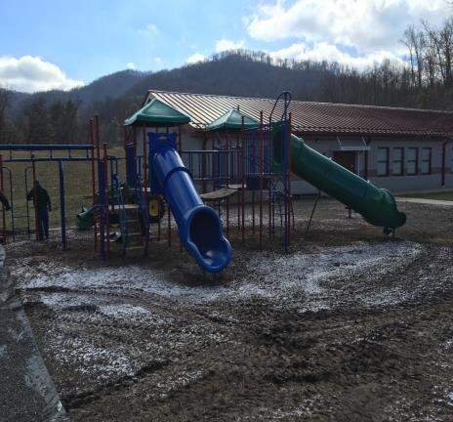
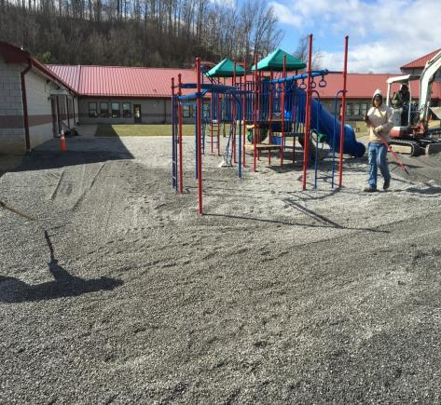
Gravel for playgrounds
Before with mulch
After pea gravel
Notes:
Currently mulch for our playgrounds costs the school system in excess of $11,375.92 annually with the need to add mulch annually
It would have cost us $10,000 for the typical mulch used on our playgrounds to put mulch on this playground
With the current guidelines we are able to replace the mulch with pea gravel at a cost of $25.00 per ton
This playground cost us $9600.00 for material which equals over 380 ton of gravel or roughly 570 cubic yards
The anticipated life expectancy of the pea gravel is 6-10 years

Slide 35
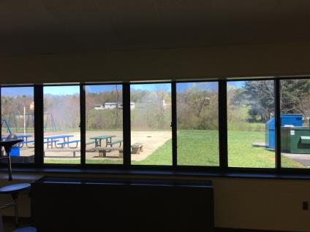
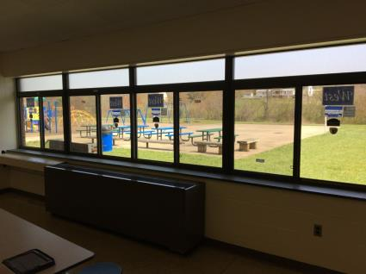
Replacement of Windows
Old Windows
New Windows
Notes:
Windows are one of our highest energy loss points in our buildings
With the aging windows and cost of energy to maintain our facilities it is justified to maintain our windows and doors
This slide shows a comparison of the windows at Meadowbrook Elementary Cafeteria
The old windows appear to be hazy. This is from a leaking seals which allows the gases to escape allowing the windows to condensate internally and cause the dirty look and making them less efficient.

Slide 36
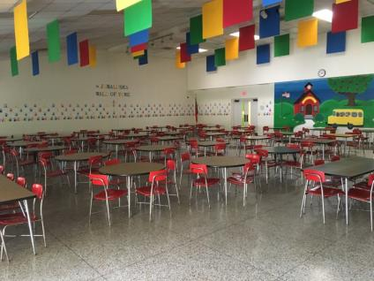
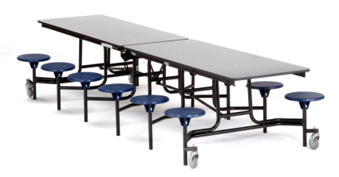
Cafeteria Tables
Junaluska cafeteria tables
Proposed tables for cafeteria
Notes:
This is a snap shot of Junaluska Elementary Cafeteria. With the increased population and the need to make this cafeteria more efficient, we are looking at the possibility of replacing these tables and chairs with tables and attached stools to help make the space for efficient. With the replacement we would be able to increase lunch room sizes, maintain student oversight, allowing teachers to keep their students in one general area rather than spread out. Increase the amount of students this cafeteria will hold during a lunch period.
The New tables budget cost is $1300.00 per table. Budget cost to replace all the tables is $35,000
This equals approximately 27 tables and 324 seats

Slide 37
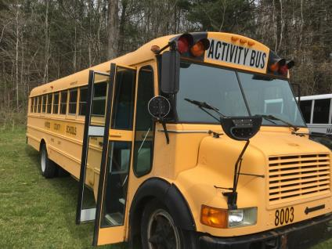
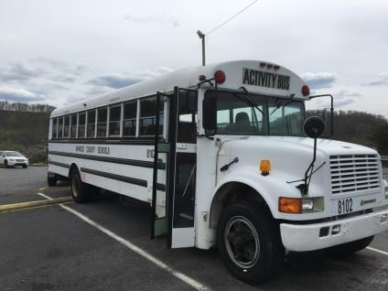
Activity Bus & Cameras
Notes:
With the additional funds from our capital we would be able to replace an activity bus annually. Currently our activity buses are on average 20 years old. With the increased age and high mileage the maintenance cost are higher to maintain these vehicles.
The cameras will increase security for faculty and students
The Yellow Bus was Manufactured in Nov 1993 This Bus is 22 years old This bus was actually taking players to a game at the time of the picture.
The White Bus was Manufactured in Nov 1992 This Bus is 23 years old

Slide 38
Capital Expense 15-16
Notes:
This is a spread sheet of current expenditures for the capital funds currently allocated.

Slide 39
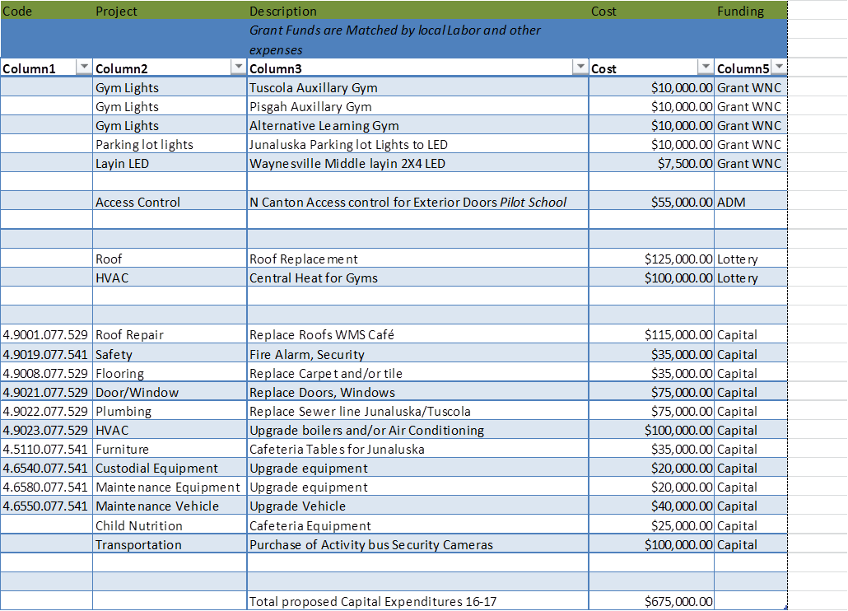
Proposed Expenditures 16-17
Notes:
The Grant was received earlier than expected. These funds are being utilized currently with projects in the school system.
The ability to offset capital expenses with lottery funds will help increase project funding for all of the school system needs.

Slide 40
Projected 5 year needs
Notes:
$680,000 projected capital needs per year. This projection is in line with the facility needs survey completed January 2016

Slide 41
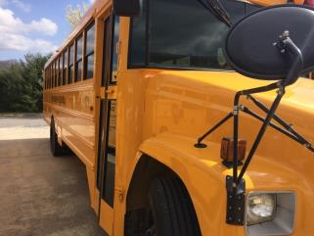
Transporting Students 2016-2017
74 Regular (yellow) School Buses
12 Spare Buses
Transporting over 3,250 students (X2) each day
750,000 miles each year

Slide 42
Transporting Students 2016-2017
21 Regular Activity (white) Buses
Average Age- 18 years old
6 Buses under 15 year old
100,000 miles each year

Slide 43
Activity Bus
14-15 | # Buses | Average Mileage | Route Miles | Annual Operating Cost | Cost Per Mile
20+ | 11 | 164,431 | 30,550 | $88,561.30 | $2.90
10 -20 | 8 | 168,916 | 37,340 | $65,306.74 | $1.75
Under 10 | 4 | 71,983 | 39,213 | $43,050.76 | $1.10

Slide 44
Transporting Students 2016-2017
Transportation Capital Outlay Request
$85,000- 1 New Activity Bus
$15,000- 5 Camera Systems for New School Buses ($3,000 each)

Slide 45

The State of Child Nutrition
2010 - 2015

Slide 46
Food Cost
2010 $ 1,868,671.74
2011 $ 1,877,490.34
2012 $ 2,027458.44
2013 $ 2,129,758.70
2014 $ 1,980,399.02
2015 $ 1,886,175.50
Notes:
Why? In addition to the state of the economy and the rising food costs, the Child Nutrition Reauthorization of 2010 has brought many changes to our USDA regulations. The two changes that have had a huge impact on our food cost are: requiring more whole grains and additional servings of fruits and vegetables. With additional requirements added in 2014 we have seen a decrease in participation and in A la Carte sales and the amount of food purchased is less than previous years.

Slide 47
Labor Cost
$ 1,838,412.85
2011 $ 1,775,218.07
$ 1,723,949.16
$ 1,705,854.31
2014 $ 1,563,750.85
2015 $ 1,531,322.20
Notes:
When I started in April of 2009 we had approximately 120 employees and 6 Office Staff. Since then we have been working to eliminate positions as people retired or quit. We currently have 87 employees and 4.5 CN Office Staff.

Slide 48
Cost of benefits
2010 772,762.85
2011 815,832.15
2012 860,846.80
2013 892,553.35
2014 869,372.15
2015 691601.79
Notes:
Even though we began cutting labor in 2009 our benefit costs continued to rise. In the 2014 & 2015 we had several retirements and we were able to eliminate benefits by completely eliminating positions or changing the positions to part time.

Slide 49
Expenses

Slide 50
Revenue
Notes:
Revenue has fluctuated very little until you see the decrease in 2015. The majority of this loss is from A la Carte Sales due to the implementation of the USDA Smart Snack Requirements. Difference of $381,668.26 from 2014-2015.

Slide 51
Meal Price Increases
Breakfast Lunch Elem Lunch Middle & High
2010 $1.00 $2.00 $2.25
2011 $1.00 $2.00 $2.25
2012 $1.00 $2.00 $2.25
2013 $1.00 $2.10 $2.35
2014 $1.00 $2.20 $2.45
2015 $1.00 $2.30 $2.55
2016 $1.25 $2.40 $2.65
Notes:
Starting in the school year 2012-2013 USDA implemented requirement to increase lunch prices by $.10 per year until they are equal to the USDA Reimbursement Rate.

Slide 52
Fund Balance
2010 $ 913,230.92
2011 $ 747,288.71 ($165,942.21)
2012 $ 496,654.07 ($250,637.64)
2013 $ 103,830.75 ($392,820.32)
2014 $0.00 BOE Transferred $3,617.09 to CN ($103,830.75)
2015 $0.00 BOE Transferred $61,447.00 to CN
Notes:
Depleted our fund balance school year 2013-2014, BOE had to give CN $3,617.09. School year 2014-2015 BOE had to give CN $ 61,447.00.

